Slide 1

STAT 425
Customer Churn for Telecom Data
Himnish Jain, Emily Hylbert, Kushal Agarwal

Slide 2
Agenda
Why we chose this topic
What is the dataset
How is this dataset feeling today
What we are hoping to learn from this analysis
Our findings
Conclusion
Notes:
E

Slide 3
Why this topic is important
This dataset allows us the following important insights into customer behavior:
Retention Strategies: Subscription length and churn rates are vital metrics for gauging customer loyalty.
Strategic Pricing Decisions: Understanding the charge amount and its relationship with customer behavior can inform pricing strategy decisions.
This analysis could help the business identify the most promising targeting opportunity or next best action based on the value of a given customer.

Slide 4
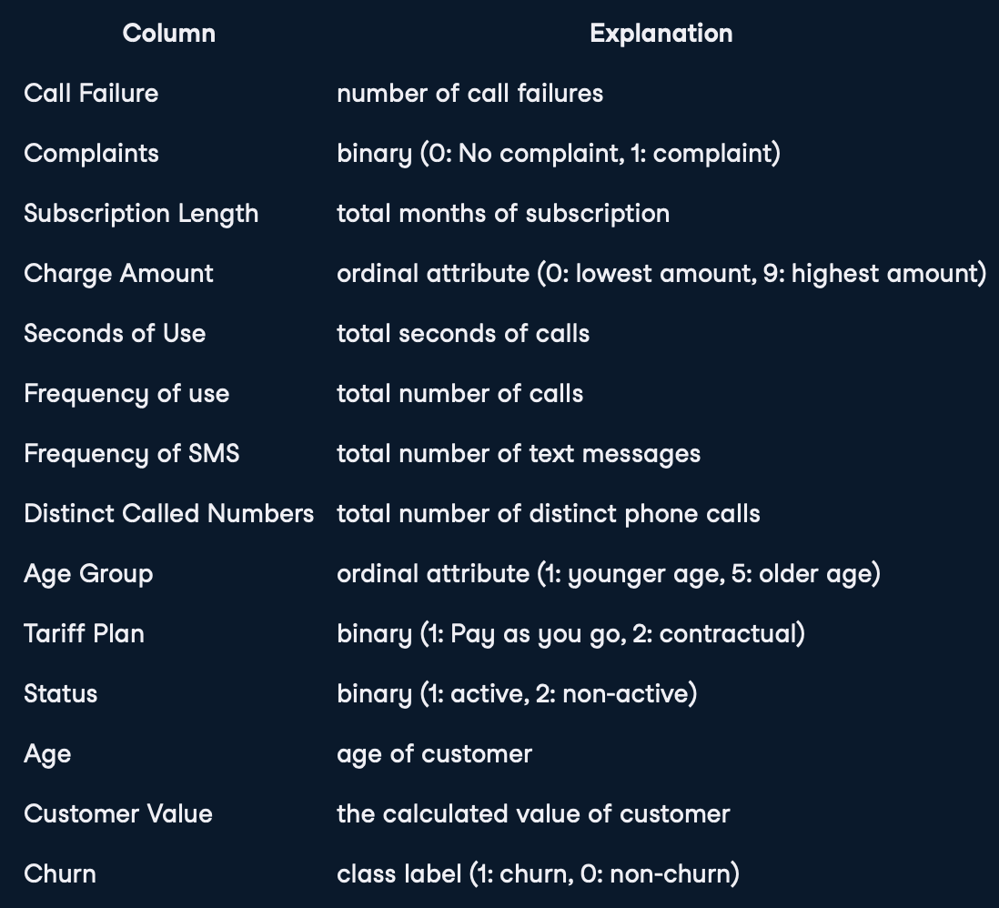
What is the Dataset?
The dataset contains the following columns:
Notes:
E

Slide 5
Key Assumptions about MLR
The residual values are normally distributed.
There must be a linear relationship between the dependent and the independent variables.
Multicollinearity: independent variables are not highly correlated with each other
The homoscedasticity assumes that the variance of the residual errors is similar across the value of each independent variable.
Notes:
Normally Distributed: This is checked by either using a normal probability plot or a histogram.
Linear Relationship: This can be illustrated by scatterplots showing a linear or curvilinear relationship.
Multicollinearity: meaning that the independent variables are not highly correlated with each other. Multicollinearity makes it difficult to identify which variables better explain the dependent variable. This assumption is verified by computing a matrix of Pearson’s bivariate correlations among all the independent variables. If there is no collinearity in the data, then all the values should be less than 0.8.
Homoscedasticity: One way of checking that is through a plot of the predicted values against the standardized residual values to see if the points are equally distributed across all the values of the independent variables.

Slide 6
What are we hoping to achieve from this analysis today
Assist companies in understanding how to use past data to analyse and make informed decisions
Understand consumer behaviour and motivations

Slide 7
Our Findings

Slide 8
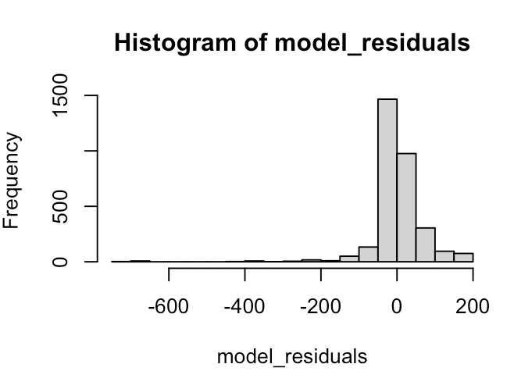
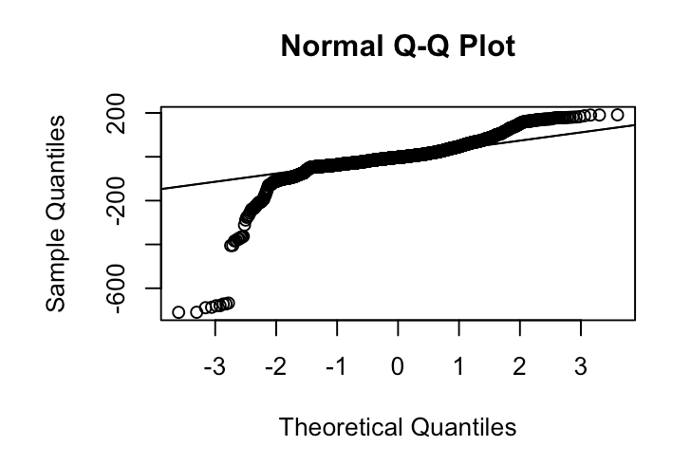
Distribution of Model Residuals
The histogram looks skewed to the left; hence we can not conclude the normality with enough confidence. Instead of the histogram, let’s look at the residuals along the normal Q-Q plot. If there is normality, then the values should follow a straight line. From the plot, we can observe that a few portions of the residuals lie in a straight line. Then we can assume that the residuals of the model do not follow a normal distribution.

Slide 9
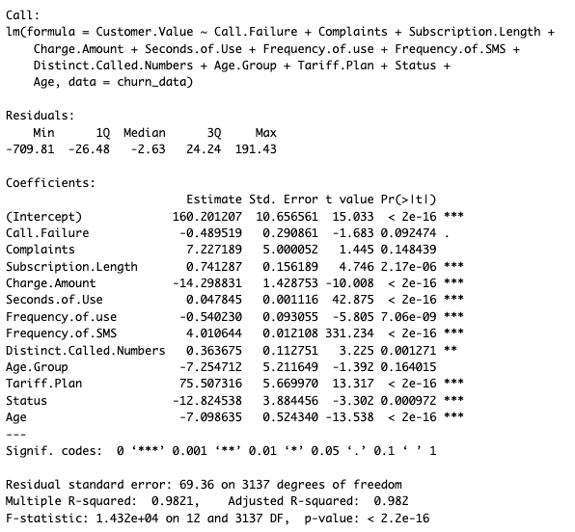
Summary of
the full model
We see that we have a strong model with High F-statistic and low p-value. But we notice some potentially collinear predictors in additional to statistically insignificant ones.
So let’s experiment with some reduced models.

Slide 10
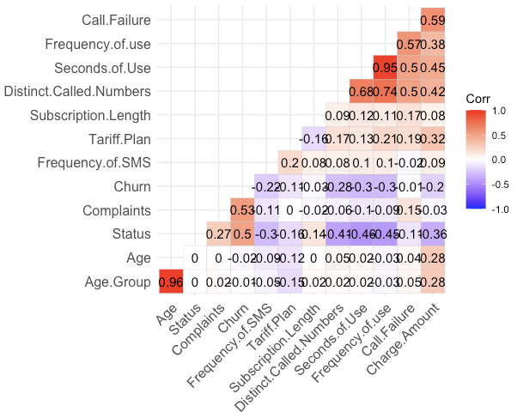
Multicollinearity
We see a strong positive correlation between age and age group and Seconds.of.use and Frequency.of.use.
Let’s build a model eliminating Age Group and Frequency.of.use due to them being lesser statistically significant than their correlated counterparts

Slide 11
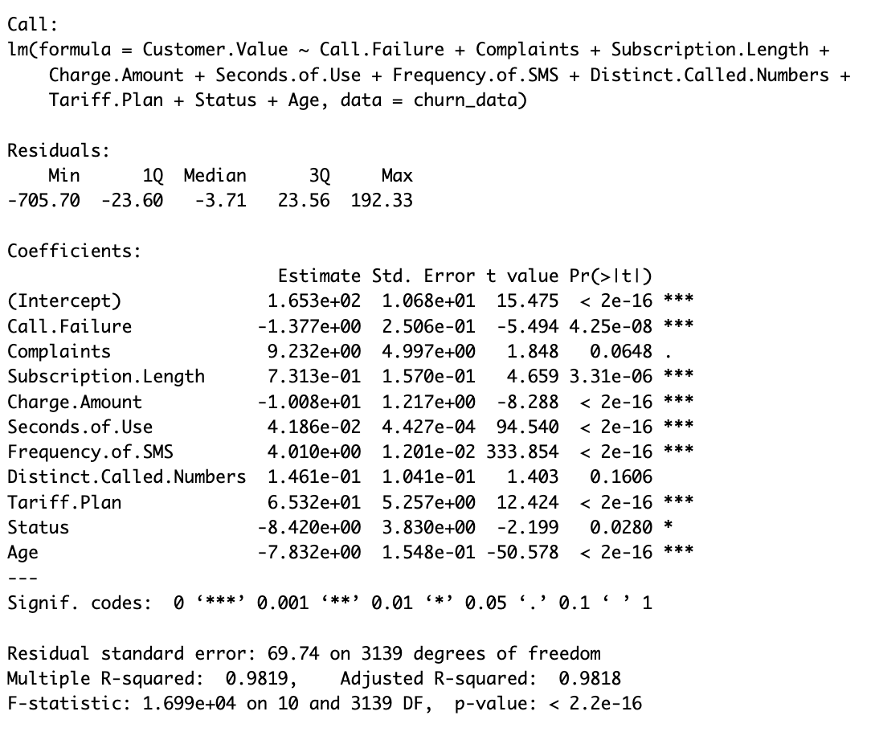
Summary of the Reduced Model
(Collinear Predictors Removed)
We see a significant improvement in F-statistic, as it goes up by 3e+04.
So a reduced model with statistically lesser significant collinear predictors are removed performs better. Let's further check this using ANOVA (F-test)

Slide 12
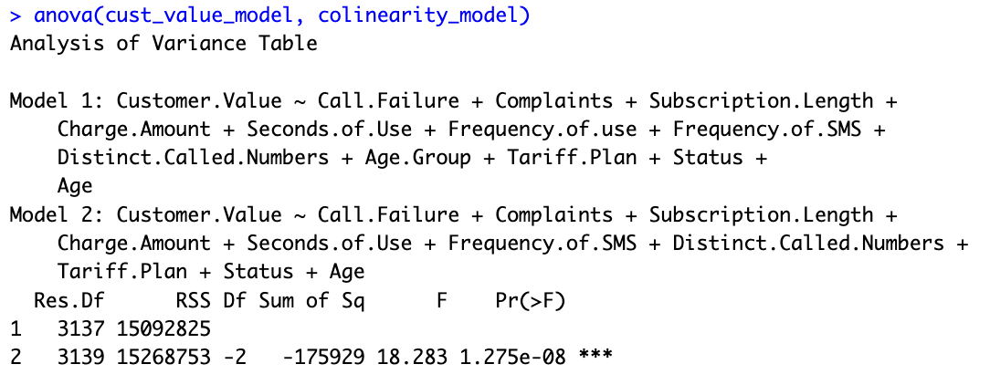
ANOVA of the
Full model and the
first reduced model
ANOVA tells us a different story. The p-value is much lesser than 0.05, rejecting the null hypothesis that the reduced model is better.
We find this interesting because it shows that the full model with collinear variables might explain lesser variance, but it is a better fit.

Slide 13
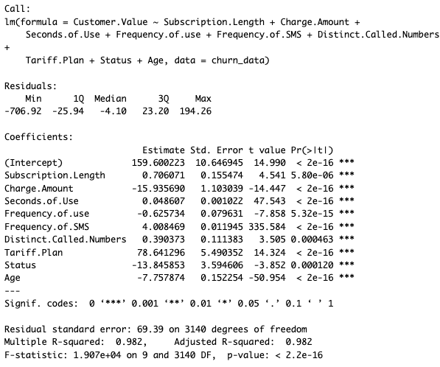
Summary of
The Model with
Only statistically
Significant predictors
The F-statistic tests the overall significance of the model by comparing the variability explained by the model to the variability not explained. The extremely low p-value (< 2.2e-16) indicates that the model as a whole is highly significant in predicting Customer.Value.

Slide 14
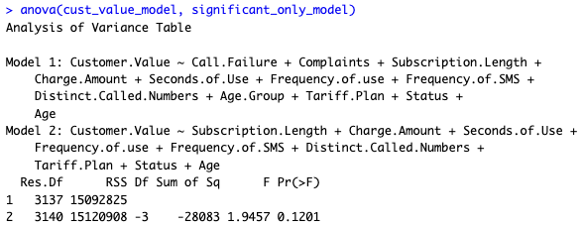
ANOVA of the
Full model and
The 2nd reduced
model
The p-value associated with the F test is 0.1201 which is greater than 0.05. Therefore, we fail to reject the null hypothesis that the reduced model is significantly different from the full model. This suggests that reduced model provides a better fit.

Slide 15
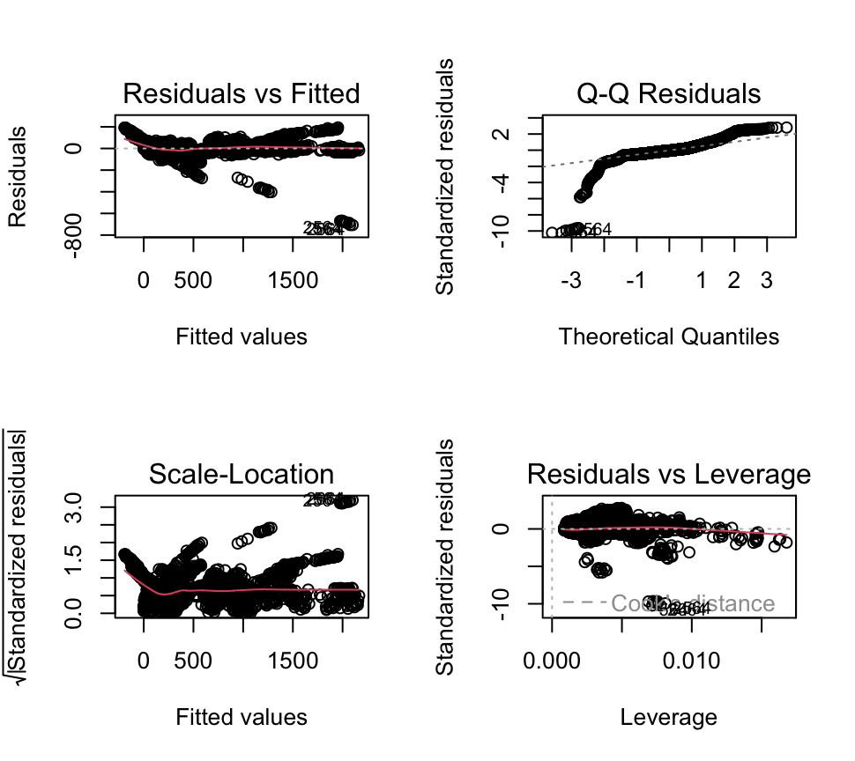
Plots - 2nd Reduced Model
Residuals vs. Fitted
Displays Linearity
Q-Q Residuals
Demonstrates data is not normally distributed
Scale-Location
Variance of residuals mostly constant
Residuals vs. Leverage
Points further off from 0, potential for influential points
Notes:
Plots reflect the validity of the model (follows key assumptions previously discussed)
Residuals vs. Fitted: Linearity
Q-Q: shows if normally distributed
Scale-Location: homoscedasticity (variance of errors is constant across all independent variables)
Residuals vs. Leverage: shows if errors(or residuals) are independent of each other

Slide 16
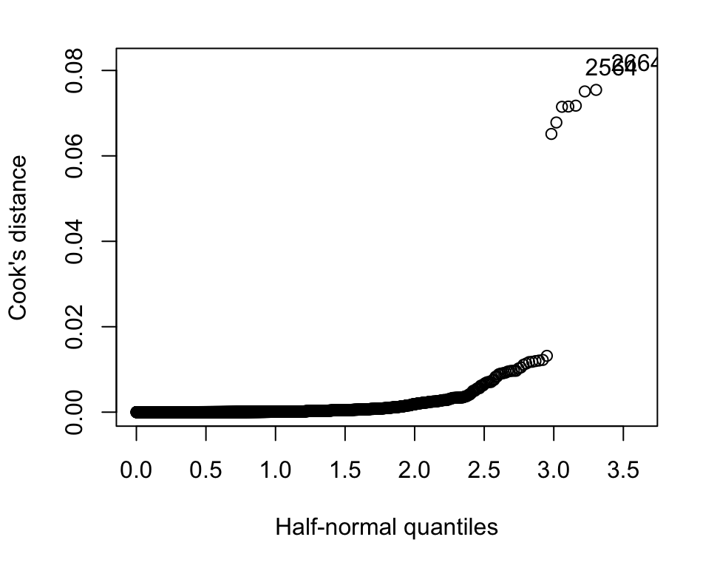
Influential
Points
The Cook’s Distance for each observation is less than 1, meaning there are no influential values, but this further exhibits the presence of outliers
Notes:
Cook’s distance: measure of change in data when each data point is removed

Slide 17
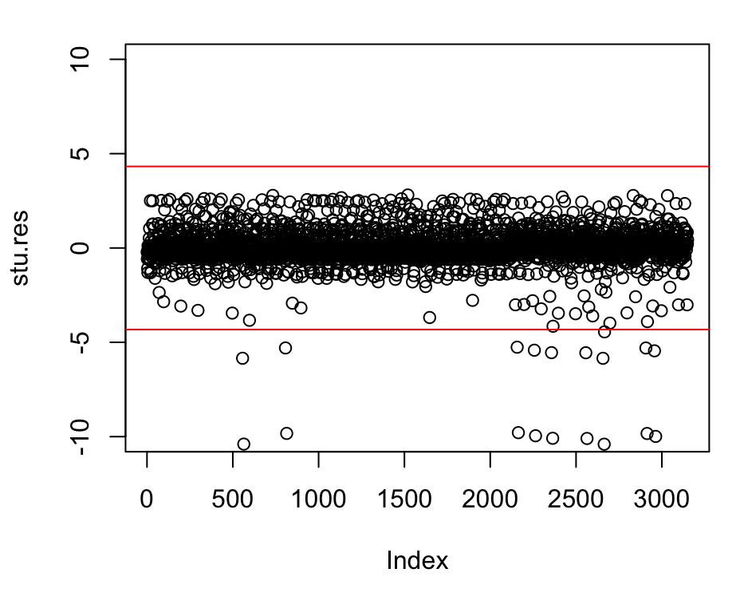
Outliers
We found many outliers within the data. Removing them and basing a model off of the clean dataset would improve the output.

Slide 18
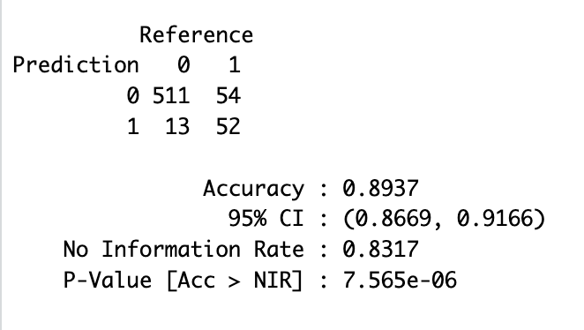
Predicting Churn
Interpretation
We got a prediction accuracy of 89.4% which is helpful in identifying core focus areas.
The model shows good predictive ability with high accuracy and sensitivity. However, specificity and the balance between false positives and negatives suggest room for improvement, especially in correctly predicting churn cases. The significant predictors, such as Complaints, Call.Failure, and Charge.Amount, highlight areas potentially impacting customer decisions to churn. This data can help us and many companies identify and form strategies around customer retention.
Notes:
No Information Rate: accuracy that would be achieved by always predicting the most frequent class in the dataset.

Slide 19
Conclusions
Based on our analysis, this company has the ability to adjust customer value through focusing on more significant predictors, including charge amount, age, and minutes of use.
Focusing advertisements towards specific payment plans, age groups, and minutes used that yield a higher customer value and churn rate.
The company can also hold a better understanding of the amount of customers they expect to maintain in coming years using our prediction model.
Notes:
E

Slide 20
Questions?

